Slide 1

MVOTI TO UMZIMKULU CLASSIFICATION STUDY
SESSION 1: APPROACH TO EVALUATE AND COMPARE SCENARIOS AS AN AID TO DECISION MAKERS TO RECOMMEND A SCENARIO AND WATER RESOURCE CLASS
ECOLOGICAL CONSEQUENCES: RATING METHOD
Delana Louw
DWA CORPORATE IDENTITY
Presented by:
Johan Maree
Deputy Director: Media Production
12 December 2012

Slide 2
Determining ecological consequences of scenarios
Need to answer the ‘what if’ questions
Express in terms of change in Ecological Category AND degree in which the REC is met
Detailed process to predict changes in all the biophysical components per site and per scenario.
Then to integrate and demonstrate in systems context
Include in MC DSS process

Slide 3
Determining ecological consequences of scenarios
Geomorphology
Geomorphology
Geomorphology
AVERAGE SCORE FOR EACH SCENARIO & STANDARDISE TO 1
Physico-chemical
Physico-chemical
Physico-chemical
Fish
Fish
Fish
Macroinvertebrates
Macroinvertebrates
Macroinvertebrates
Riparian vegetation
Riparian vegetation
Riparian vegetation
Consequences
Consequences
Consequences
EC FOR PES & REC
EC FOR SC
COMPARE EC TO REC
Evaluate scenarios
Determine PES, REC and %
Predict EC and %
Determine degree to which REC is met
Rank Scenarios at each EWR site

Slide 4
Determining ecological consequences of scenarios
RELATIVE ECOLOGICAL IMPORTANCE OF SITES
PES
EIS
Locality in conservation areas
Confidence
Length of river
WEIGHT
Ecological ranking of scenarios per EWR site
APPLY WEIGHT TO
OUTPUT
Ecological ranking of scenarios for the system

Slide 5
MKOMAZI RESULTS
Proposed Smithfield Dam
MK_I_EWR 1
MK_I_EWR 2
MK_I_EWR 3
Sappi
Estuary

Slide 6
MK_I_EWR1: Component ecological consequences
Component | PES & REC | Sc MK2 | Sc MK21 | Sc MK22, 23 | Sc MK31 | Sc MK32, 33 | Sc MK4 | Sc MK41 | Sc MK42
Phys chem | A/B | C | A/B | A/B | B | B | B | A/B | A/B
Geom | A/B | C/D | B/C | C | B/C | C | C | B/C | C
Fish | B | D | B/C | C | C | C | D | C | C
Inverteb | B/C | D | B/C | C | C | C | C/D | C | C
Rip veg | C | D | C | C | C | C | C/D | C/D | C/D
EcoStatus | C | D | C | C | C | C | C/D | C | C
Geomorphology - reduced to different degrees - impact of the dam on sedimentation and possible erosion and accumulation of fines.
These habitat changes impact on the instream biota (worst scenarios are Sc MK2 and 4 as they do not include EWR).
This results in a lack of fast flowing habitats and possible reduction and/or eradication of ANAT and BNAT
Scenarios that include EWR releases are an improvement, but the unseasonal releases and at times higher flows than natural are problematic.

Slide 7
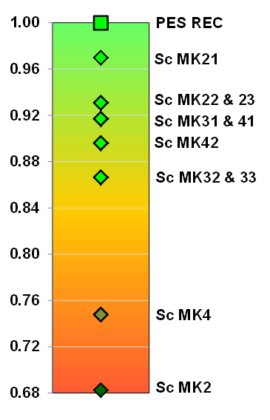
MK_I_EWR1: Scenario ranking
Most of the scenarios meet the ecological objectives in terms of EcoStatus except for Sc MK4 and MK2.
These two scenarios do not cater for EWR requirements and are similar, however under Sc MK2 lower flows occur in all months and zero flows occur during drought periods in Oct – Dec and therefore Sc MK2 has the greatest impact. None of the scenarios meet the ecological objectives for all the components. Sc Mk 21 are the best of the options overall and is therefore ranked the highest

Slide 8
MK_I_EWR2: Component ecological consequences
Component | PES & REC | Sc MK2 | Sc MK21 | Sc MK22, 23, 32, 33 | Sc MK31 | Sc MK4 | Sc MK41 | Sc MK42
Phys chem | A/B | C | A/B | A/B | A/B | B | A | A
Geom | B | C | C | C | C | C | C | C
Fish | B | D | C | C | C | C/D | B/C | B/C
Inverteb | B | D | B/C | B/C | B/C | C | B | B/C
Rip veg | B | C | B | B/C | B | C | B | B
EcoStatus | B | C | B | B/C | B/C | C | B | B
Geomorph reduced to a C due to the impact of the dam on sedimentation, channel narrowing and an increase in embeddedness..
These habitat changes impact on the instream biota.
The worst scenarios are Sc MK2 & 4 (no EWR releases).
The other scenarios include increased high flows in the dry season with a loss of slow habitats which impact on Barbus anoplus and Barbus viviparus.

Slide 9
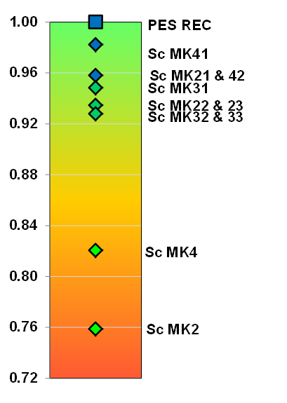
MK_I_EWR2: Scenario ranking
None of the scenarios meet the ecological objectives. Although Sc MK21, 41 and 42 results in the same EcoStatus, the instream biota are impacted by the reduced wet season base flows and reduced floods. Sc MK41 is the best scenario of these three scenarios because it provides more flows during wet season.
Scenario MK2 and MK4 has the worst impact due to reductions in baseflows during dry and wet seasons.

Slide 10
MK_I_EWR3: Scenario ranking
Component | PES & REC | Sc MK2 | Sc MK21, 31, 41 | Sc MK22, 23, 32, 33 | Sc MK4 | Sc MK42
Phys chem | A/B | B/C | A/B | B | B/C | B
Geom | B | C | B/C | C | C | C
Fish | B | C | B/C | C | C | C
Inverteb | B | C/D | B/C | C | C/D | C
Rip veg | D | D | D | D | D | D
EcoStatus | C | D | C | C | D | C/D
Geomorphology impacts are not as severe as US - distance of the dam. Reduction of large flood & delayed early wet season floods still cause impacts.
The worst scenarios are Sc MK2 & 4 (no EWR releases).
The deterioration in instream biota (small), is related to the low flows for drought in wet months and impact on spawning

Slide 11
MK_I_EWR3: Component ecological consequences
Geomorph: The results illustrate that none of the scenarios meet the ecological objectives.
Sc MK 21, 31 and 41 results in the same EcoStatus and has the least impact with a slight deterioration in geomorphology and instream biota.
Sc MK22, 23, 32 and 33 also has the same EcoStatus as the PES/REC but there is further deterioration in the instream biota as well as geomorphology and water quality.
Scenario MK2 and 4 have the biggest impact as overall they drop a category for while Sc MK42 only caters for the low flow EWR and the impact is therefore slightly less, i.e. it drops half a category

Slide 12
MKOMAZI RIVER: INTEGRATED CONSEQUENCES

Slide 13
MKOMAZI RIVER: SITE WEIGHTING
EWR site | PES | EIS | Conf | Locality in protected areas | Dist | Normalised Weight
EWR 1 | C | Moderate | 3.4 | 1 | 0.08 | 0.22
EWR 2 | B | High | 3.5 | 3 | 0.32 | 0.37
EWR 3 | C | Moderate | 3.4 | 1 | 0.6 | 0.41

Slide 14
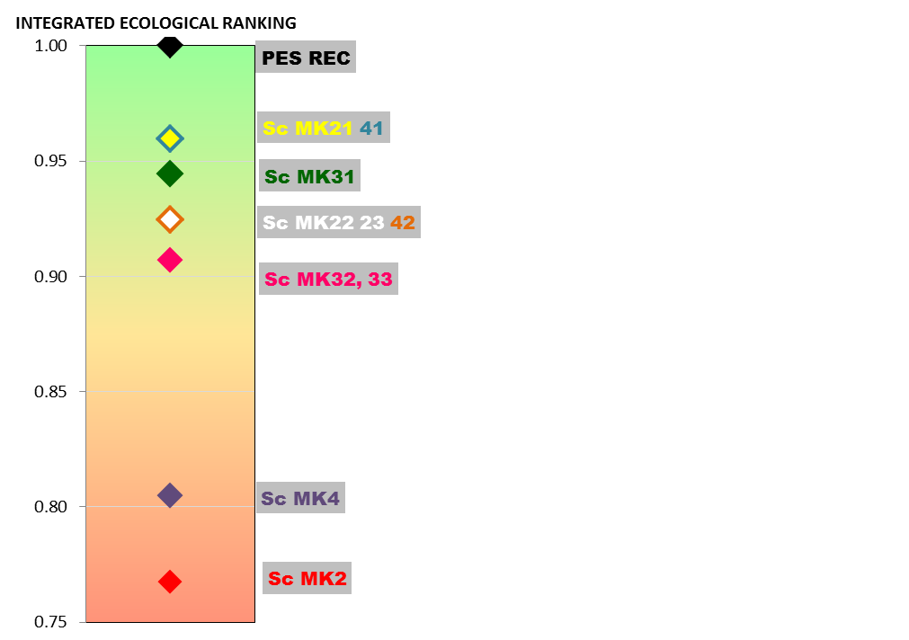
MKOMAZI RIVER: INTEGRATED RANKING
Sc MK 21 and 41 are the best options as they are the closest to meeting the ecological objectives.
Both these scenarios include the total EWR flows and the impacts are mostly due to the impacts on the dam itself, such as the barrier effect, impact on larger frequency of floods and largely due to the increased (above natural) base flows.

Slide 15
MKOMAZI ESTUARY: SENSITIVITIES
Decreased base flows – especially important for mouth closure.
Salt penetration
Decreased flooding (large estuary – flooding bigger impact than eg on the Mvoti
NB: Much improvement can be achieved by removing weir (illegal)

Slide 16
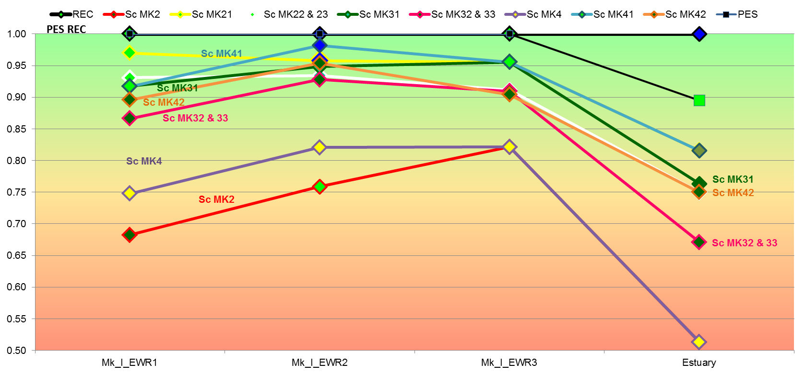
MKOMAZI ESTUARY & RIVER: RANKING

Slide 17
MKOMAZI RIVER & ESTUARY: SITE WEIGTING
EWR site | PES | EIS | River Weight | System Weight
EWR 1 | C | Moderate | 0.22 | 0.17
EWR 2 | B | High | 0.37 | 0.28
EWR 3 | C | Moderate | 0.41 | 0.31
Estuary | C | High |  | 0.25

Slide 18
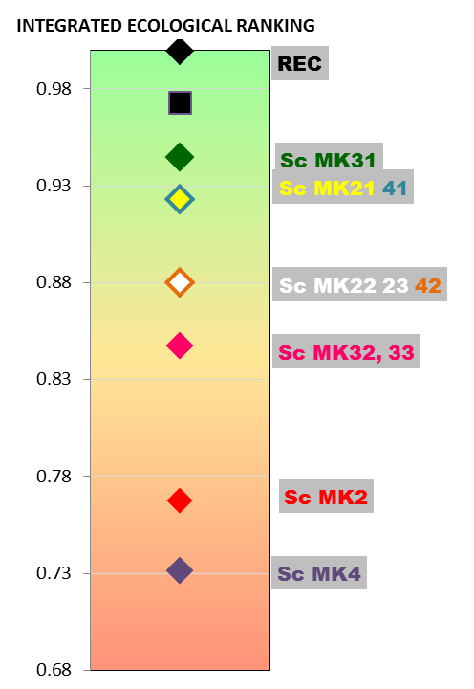
MKOMAZI RIVER & ESTUARY: INTEGRATED RANKING
RIVERS ONLY
RIVERS & ESTUARY

Slide 19
MV_I_EWR2: COMPONENT ECOLOGICAL RIVER CONSEQUENCES
Component | PES & REC | Sc MV3 | Sc MV41 | Sc MV42, 43
Phys chem | C | C/D | C | B/C
Geom | C | C/D | C | C/D
Fish | B/C | C/D | B/C | C
Inverteb | B/C | C/D | B/C | B/C
Rip veg | C/D | D | C/D | C/D
EcoStatus | C | D | C | C
Sc MV3 is the worst case as it does not include EWR releases. The channel will narrow with vegetation encroachment. An overall loss of fast habitats will impact on the instream biota.
Impacts associated with Sc MV42 and 43 are less pronounced as it includes EWR releases to some degree.
Sc MV 41 supplied the total EWR and therefore meets the ecological objectives.

Slide 20
MVOTI ESTUARY: SENSITIVITIES
Decreased base flows – especially important for mouth closure.
Salt penetration
Decreased flooding (small estuary – flooding smaller impact than eg on the Mvoti
Major impact associated with sand mining

Slide 21
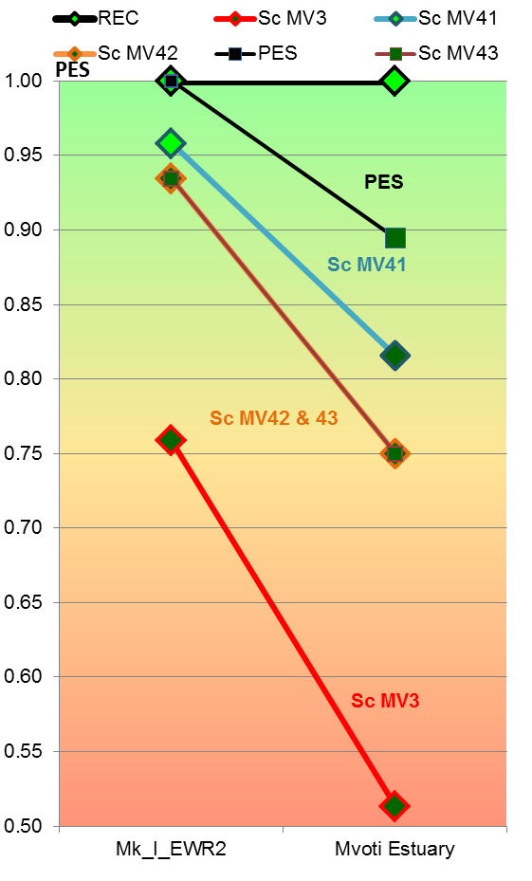
MVOTI ESTUARY & RIVER: RANKING
The ranking is the same for the rivers and estuary.
Weights need to be selected to provide ecological system rating.
Estuary probably much less important than Mkomazi and rivers more important - used 15%.
Irrespective of the weights, the ranking order will not change as can be seen.

Slide 22
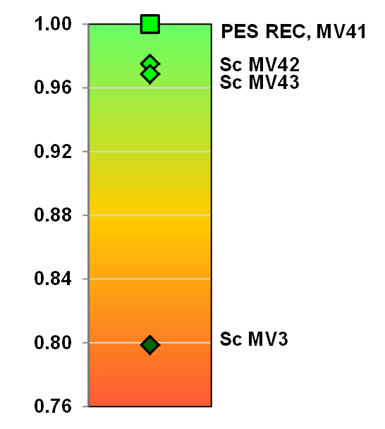
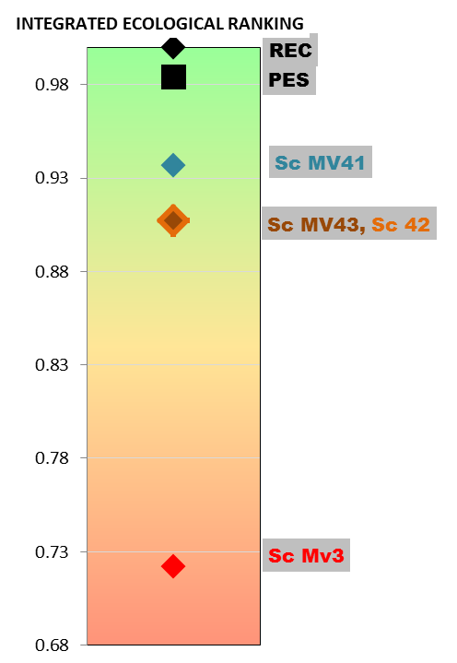
MVOTI RIVER & ESTUARY: INTEGRATED RANKING
RIVERS ONLY
RIVERS & ESTUARY

